Slide 1


Optimizing For The Future
Relocating Google's Headquarters - A Cost of Living Analysis
Presenter: Adhithya Rokhith Bhaskar

Slide 2
About the Presentation
1. Reasons
3
3
4
3. Business & Operational Costs
11
11
11
5. Recommendations
19
19
Why Relocate?
Dataset Overview
California vs National Average
Better Cities
Further Insight for Final Decision
2. Employee: Cost of Living
4. Conclusions
5
5
5
17
17
18
California vs National Average
Better Cities
Rationale
Better Prospect
google.com
3

Slide 3
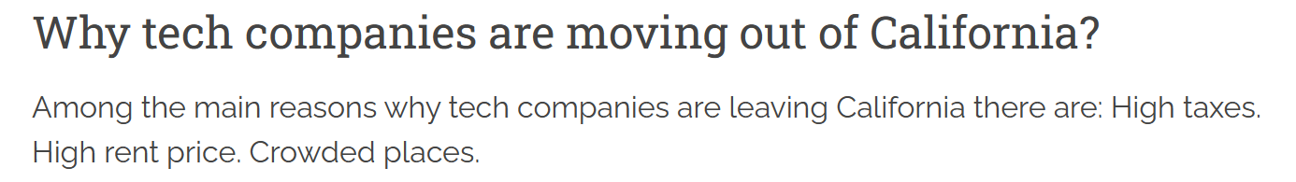
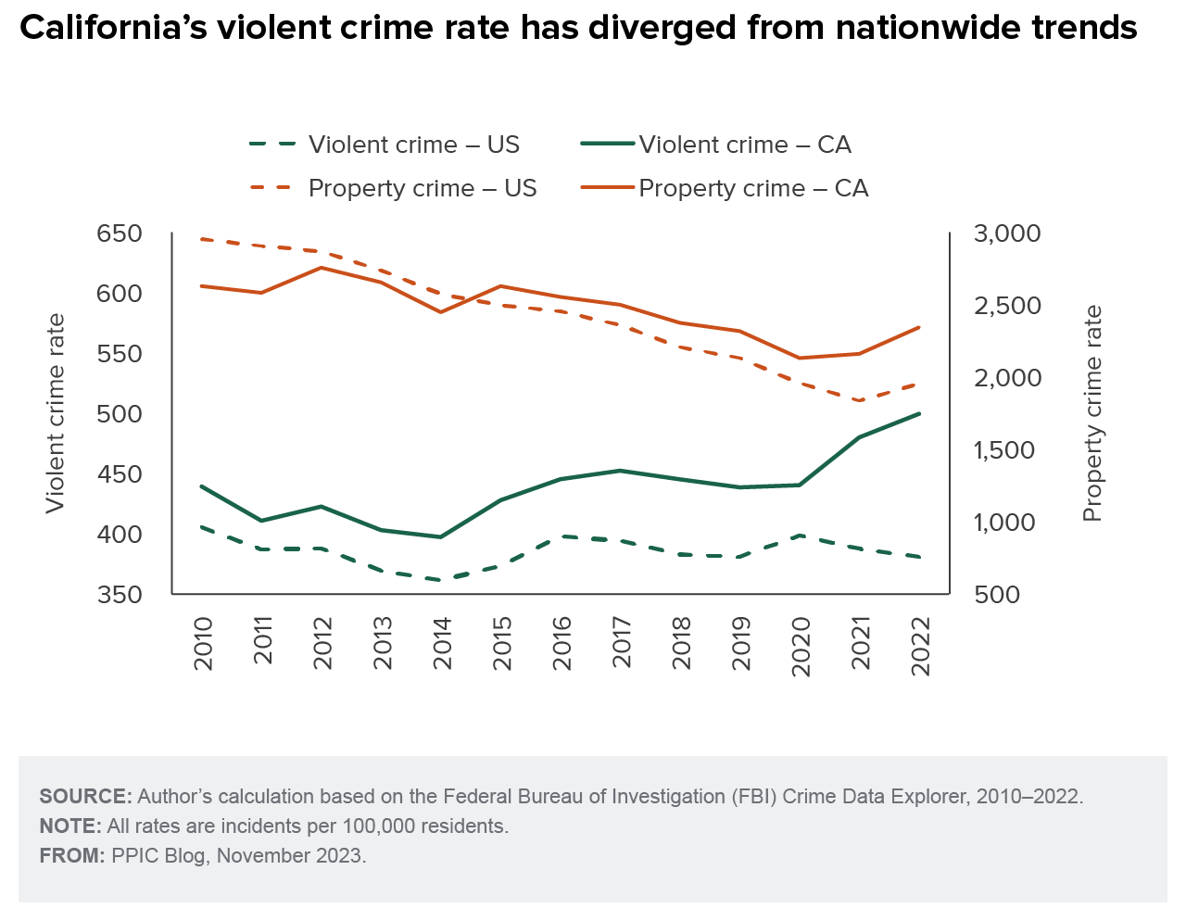
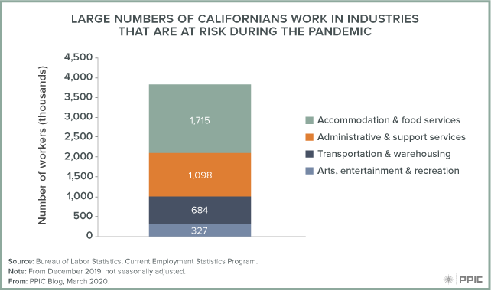
Reasons - Why to Relocate ?
google.com

Slide 4
Dataset Overview
Special Value
Dataset Content
Samples
Highly Detailed US Cities Living Costs.
Cities, States Across United States
Data Efficiency
Data Accuracy
Variables
Key Metrics
Prices of Groceries, Transportation, Utilities, Real Estates Prices, Average Salaries.
56 Columns :
Rents, Foods Prices,
Commute Costs, etc.
google.com

Slide 5
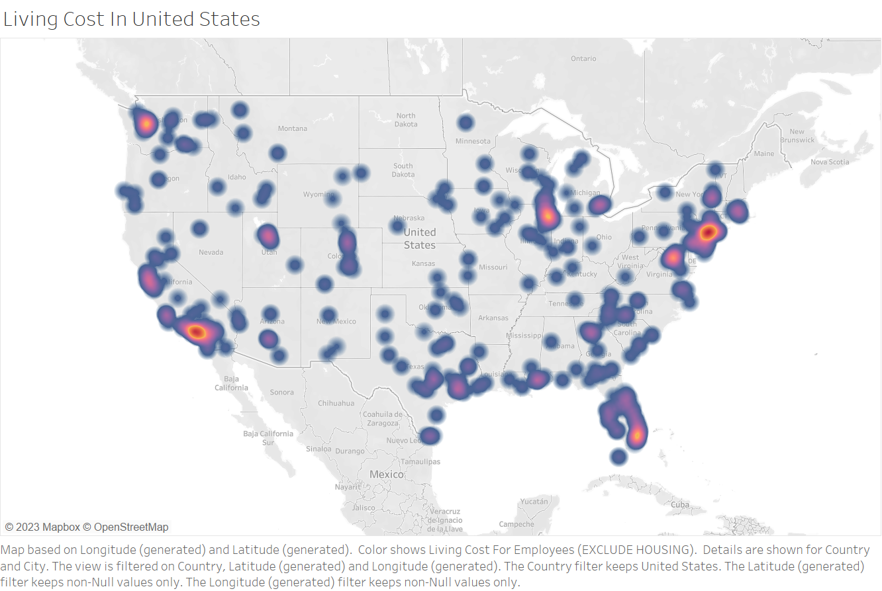
Employee: Cost of Living Overview
google.com

Slide 6
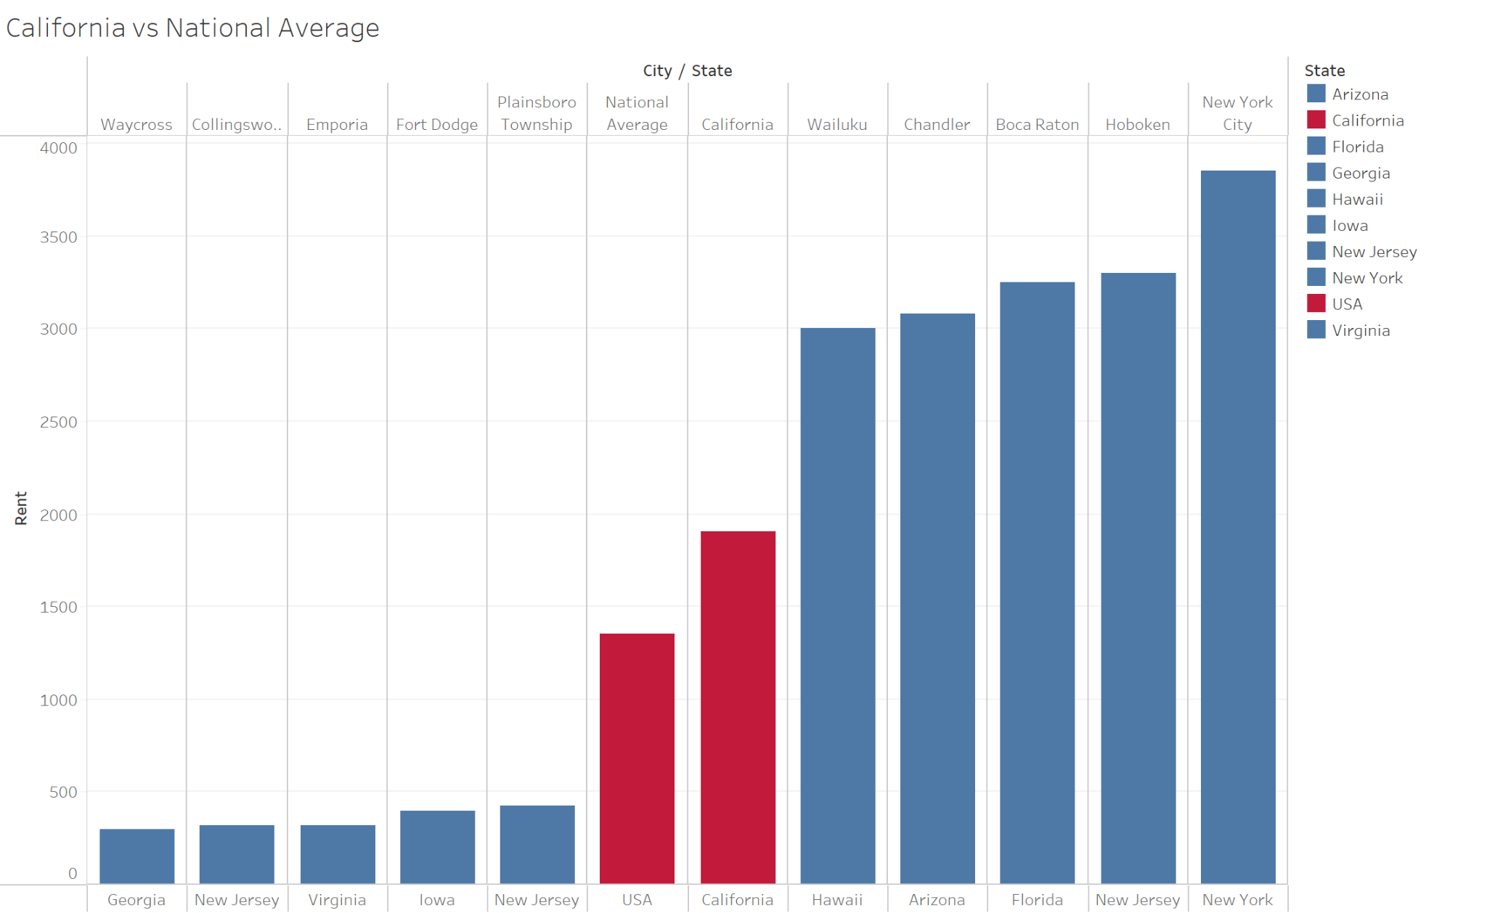
Cost of Living - Rent
Average Rent:
California is 44% higher than the National Average
Better Cities:
Cities in Georgia, New Jersey, Virginia and Iowa
google.com

Slide 7
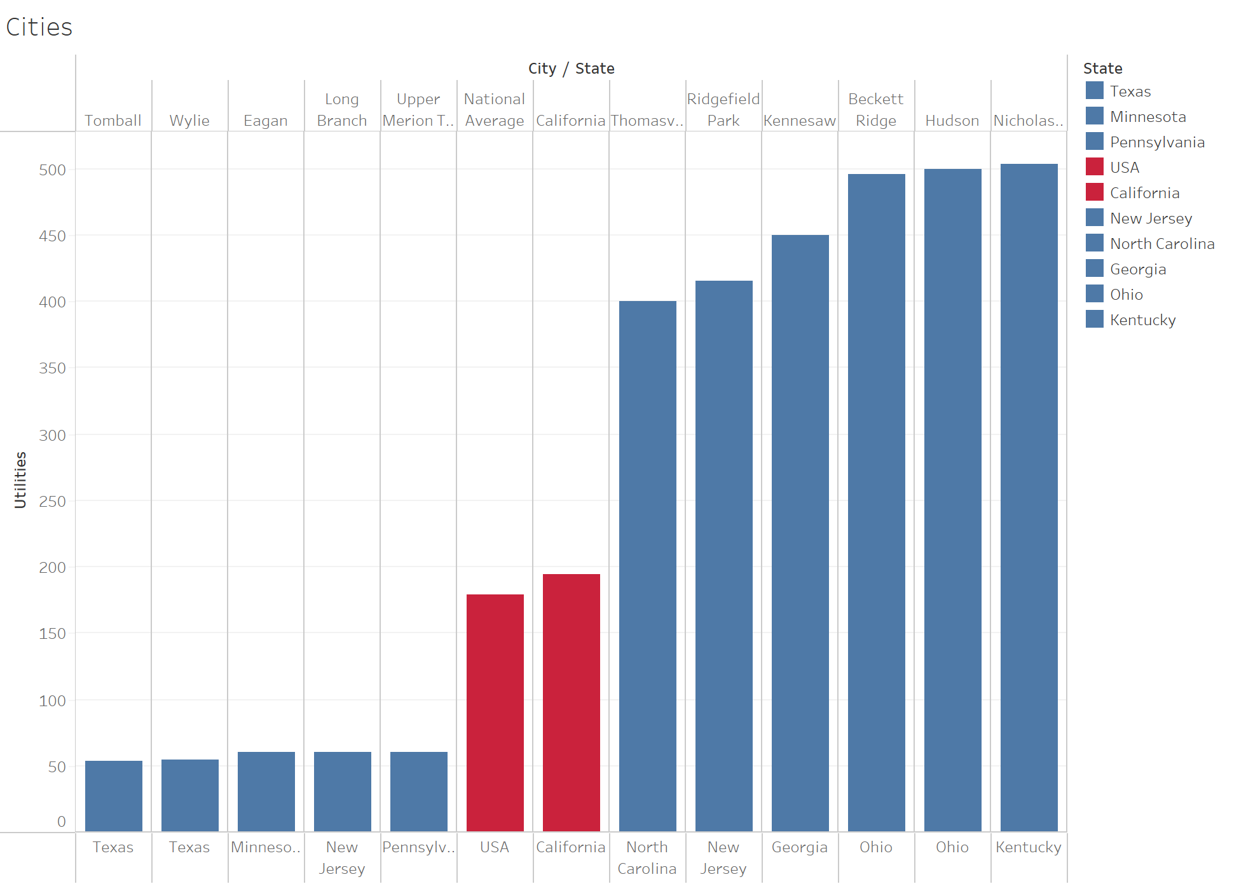
Cost of Living - Utilities
Average Utilities Cost: California is 12.5% higher than the National Average.
Better Cities: Cities in Texas, New Jersey, Pennsylvania and Minnesota
google.com

Slide 8
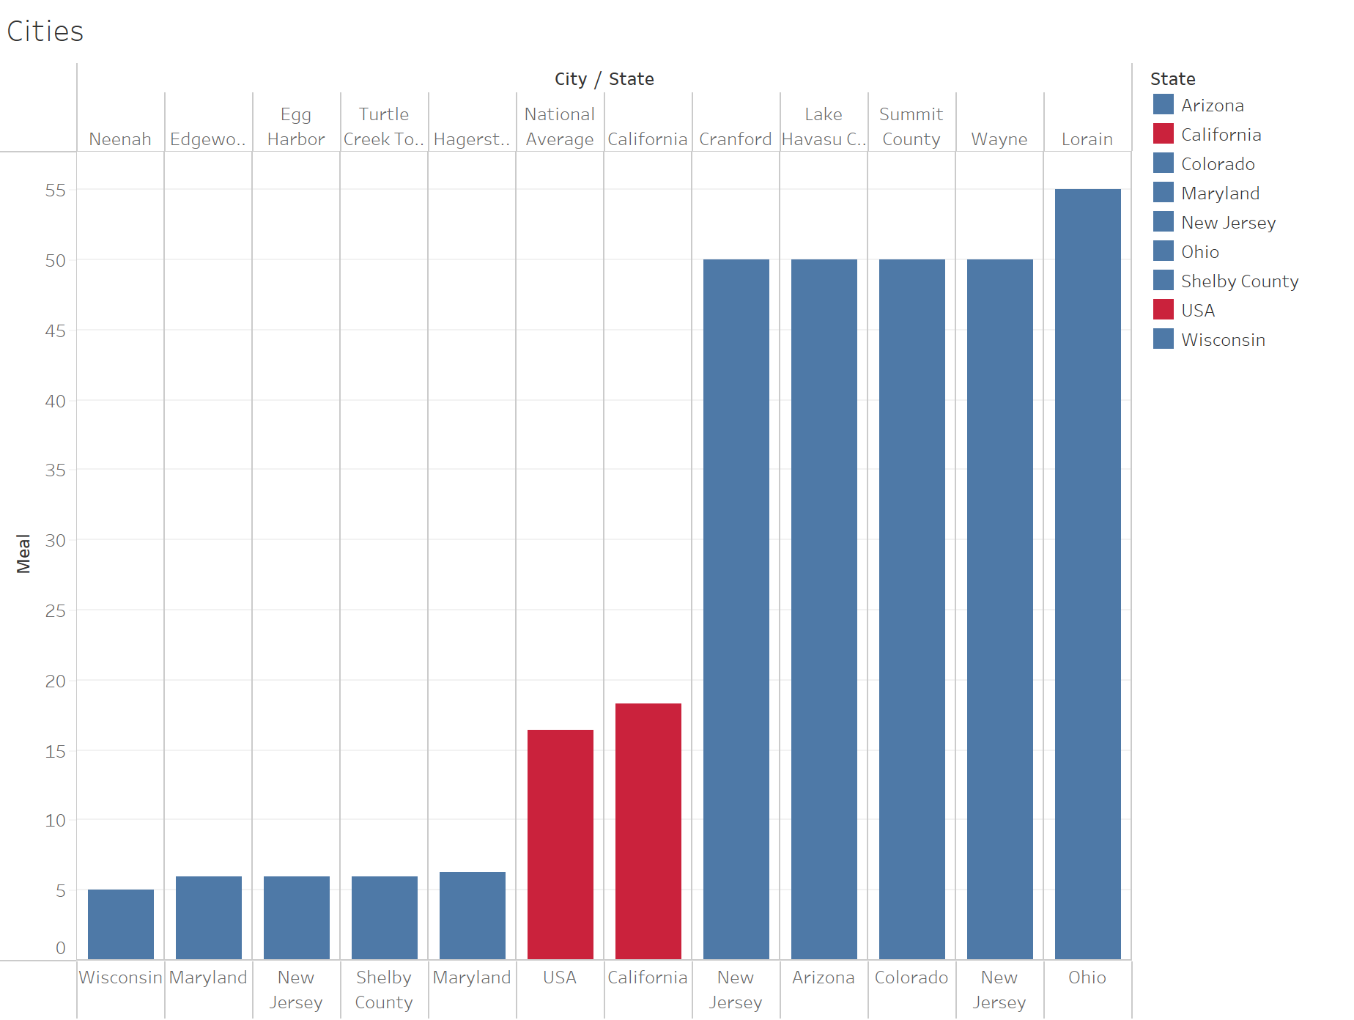
Cost of Living - Meal
Average Cost of Meals: California is 12.5% higher than the National Average.
Better Cities: Cities in Wisconsin, New Jersey, Maryland and Shelby County
google.com

Slide 9
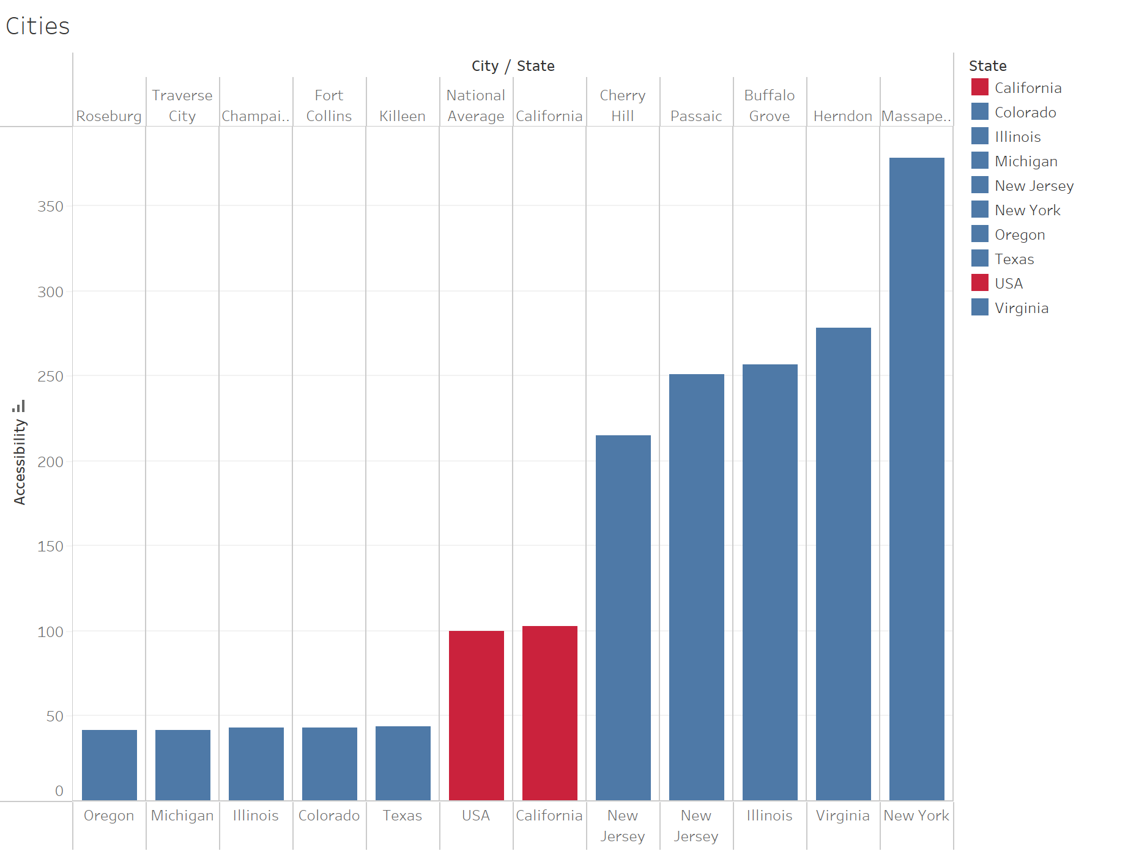
Cost of Living - Accessibility
Employee: Cost of Living: California is 4% higher than the National Average.
Better Cities: Cities in Texas, Oregon, Michigan and Illinois.
google.com

Slide 10
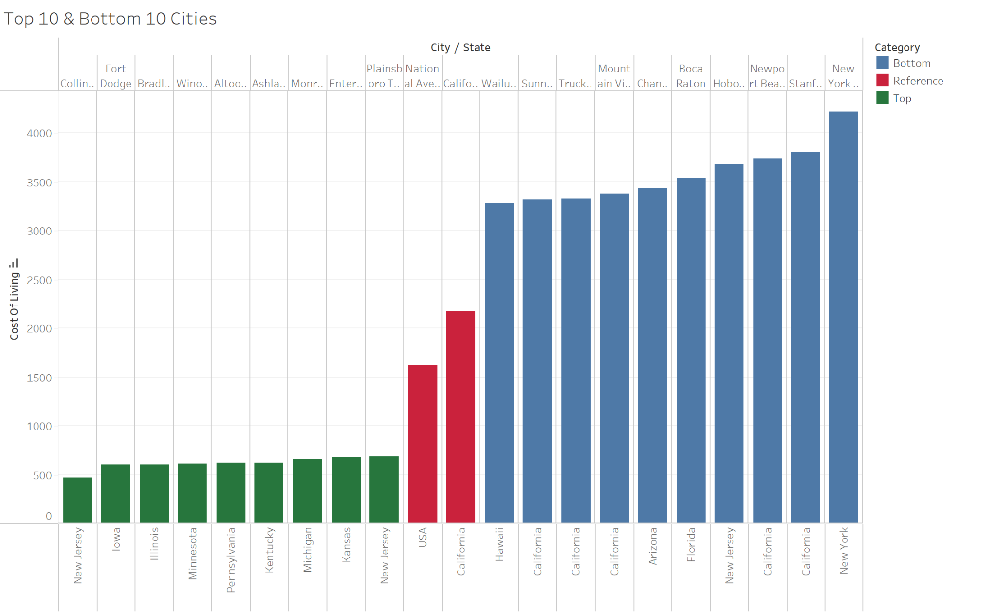
Cities Shortlisted
Top 10 & Bottom 10 Cities - Cost of Living
More than
775 cities cheaper than living in California
670 cities cheaper than the National Average Cost of Living
google.com

Slide 11
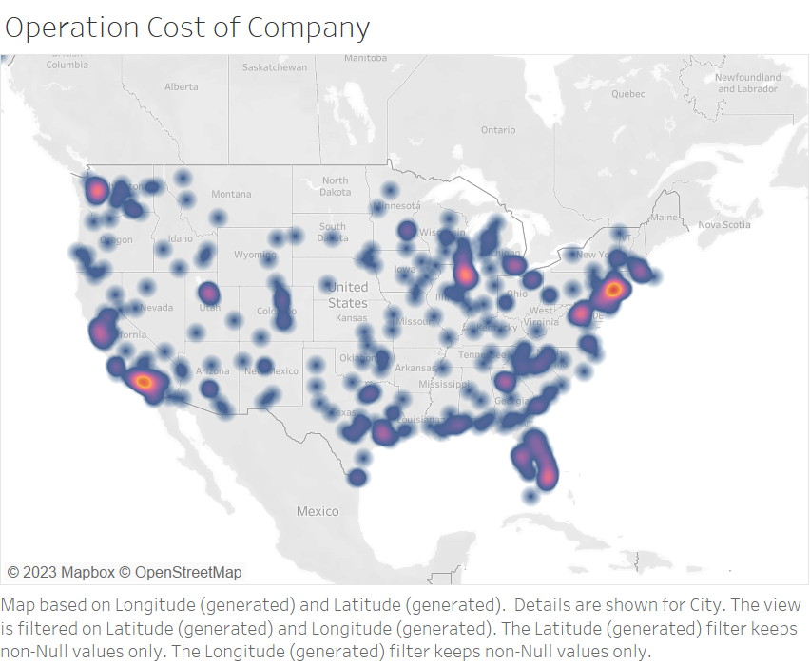
Company: Business & Operation costs Overview
google.com

Slide 12
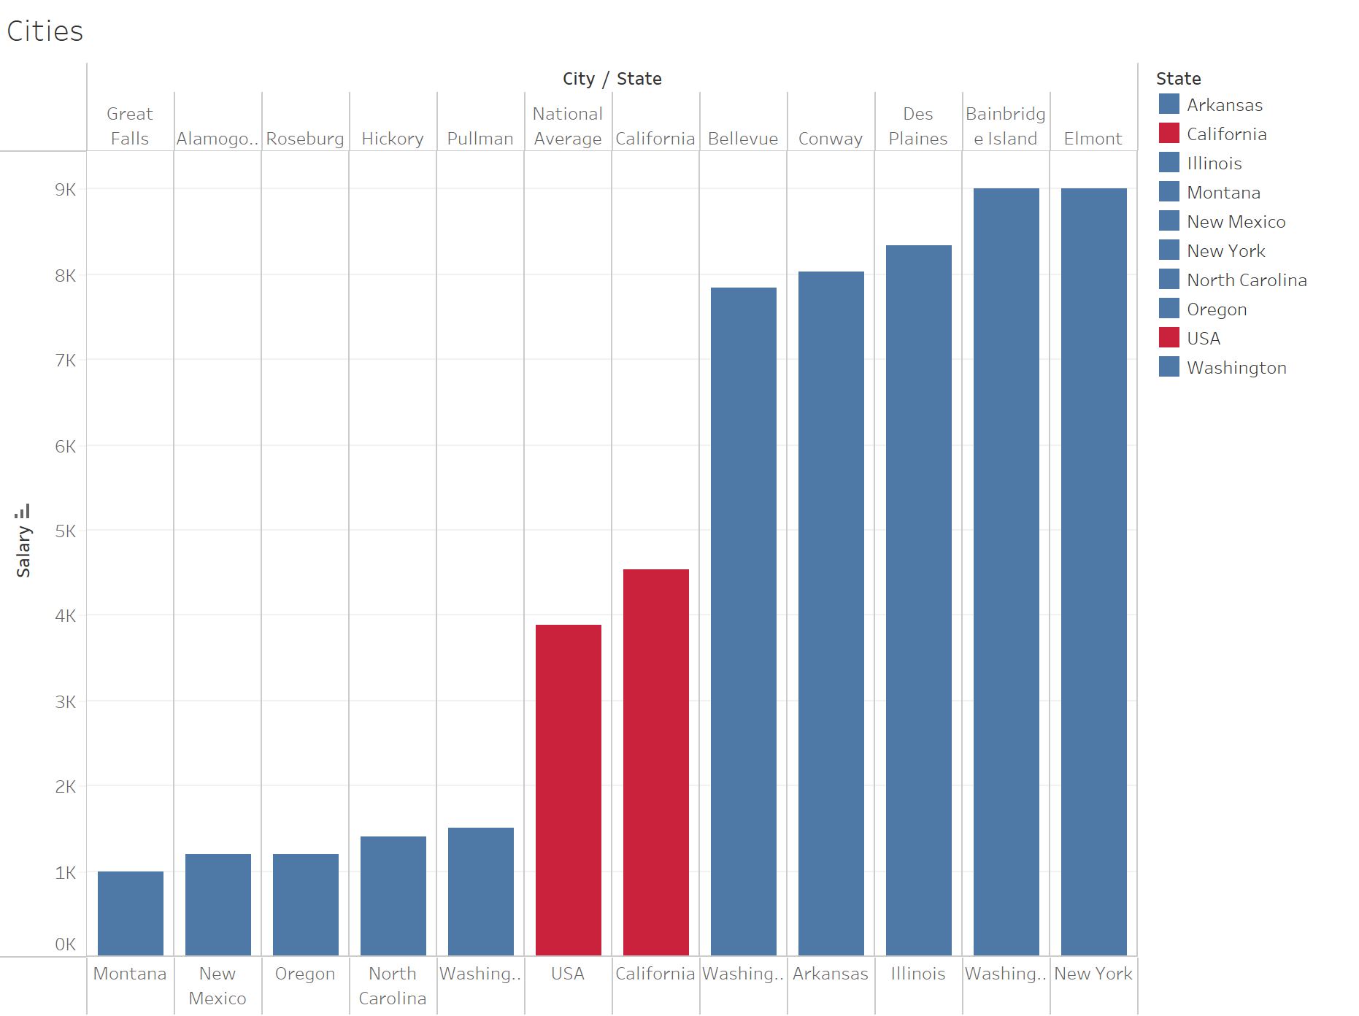
Business & Operational Costs - Monthly Net Salary
Monthly Net Salary: California is 25% higher than the National Average.
Better Cities: Cities in New Mexico, Washington, North Carolina and Oregon.
google.com

Slide 13
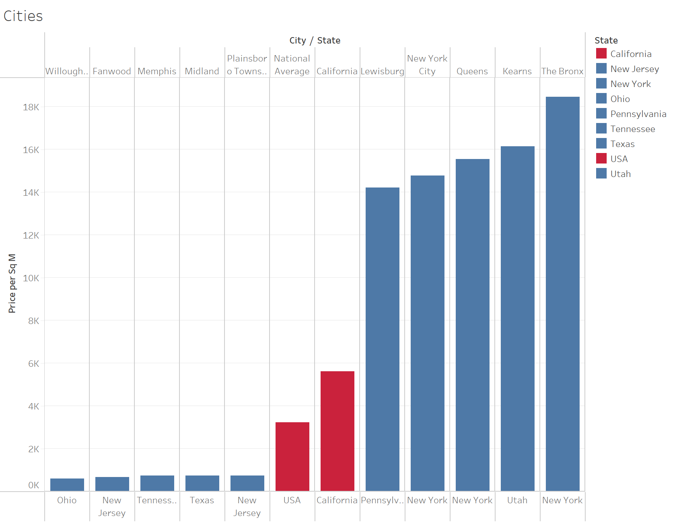
Business & Operational Costs - Price per Sq.m (inside city)
Price per Sq M Inside City: California is 95% higher than the National Average.
Better Cities: Cities in Ohio, New Jersey, Texas and Tennessee.
google.com

Slide 14
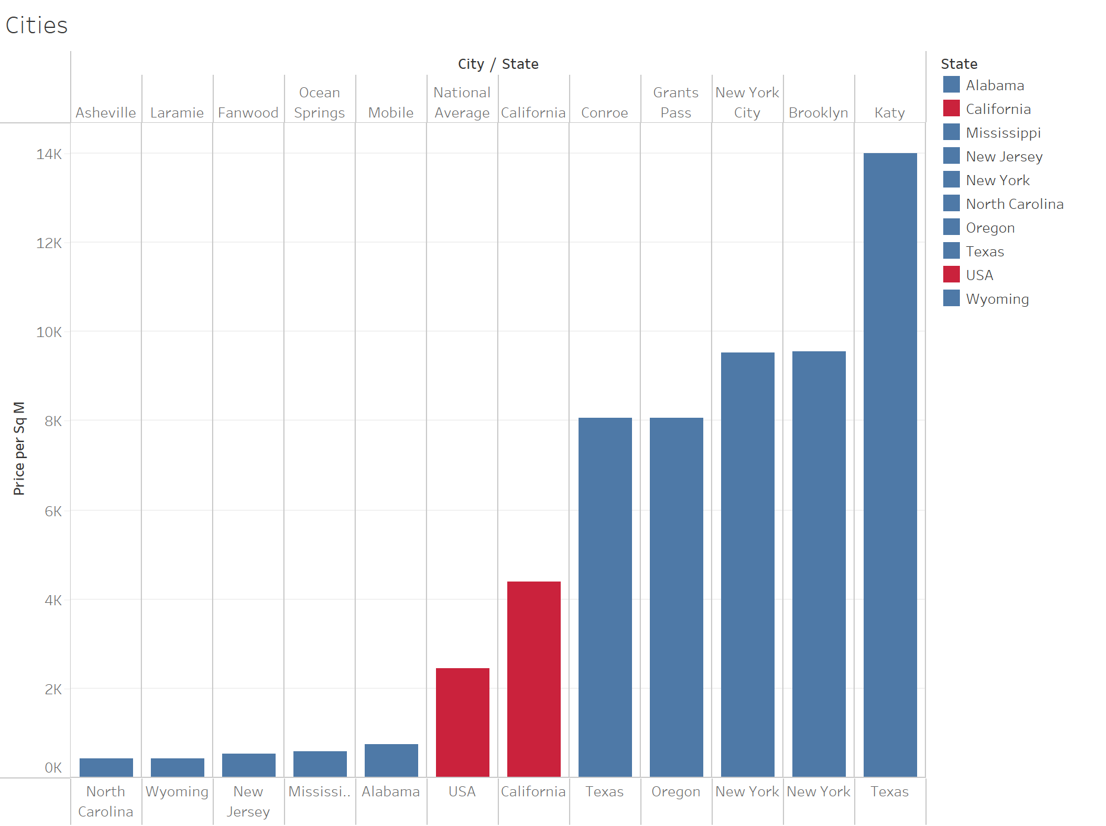
Business & Operational Costs - Price per Sq.m (outside city)
Price per Sq M Outside City: California is 80% higher than the National Average.
Better Cities: Cities in Wyoming, New Jersey, Alabama and North Carolina
google.com

Slide 15
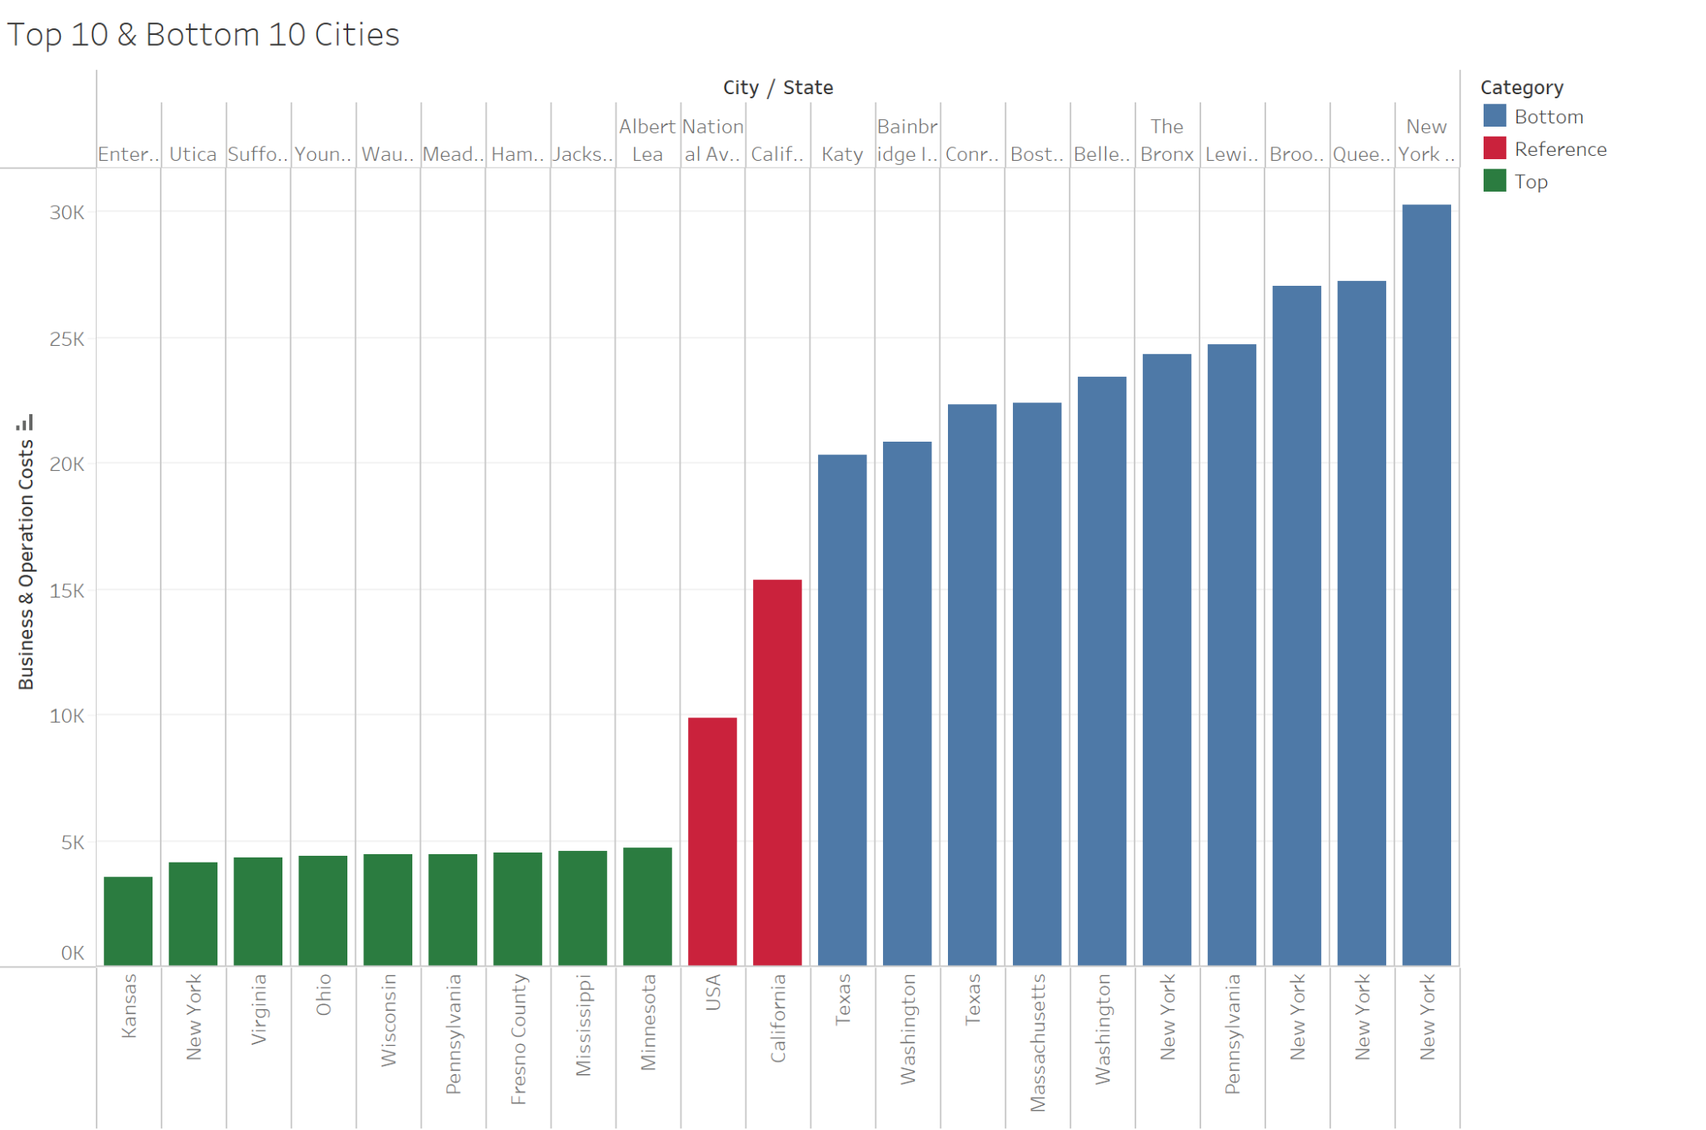
Cities Shortlisted
Top 10 & Bottom 10 Cities - Business & Operation Costs
More than 855 & 720 cities featuring above California and National Average’s Business & Operational Costs respectively
google.com

Slide 16







Conclusions - Rationale
Cost of Living Focus
Business & Operational Cost Focus
google.com

Slide 17
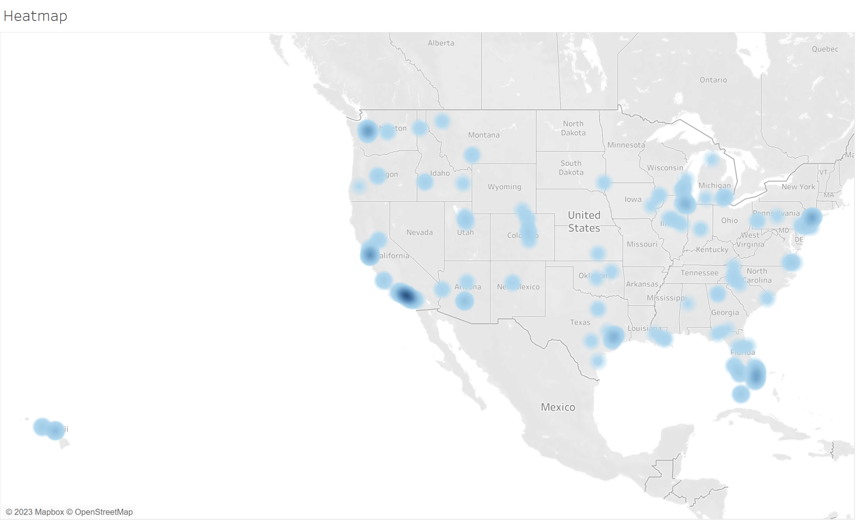
Conclusions
Better Region?
google.com

Slide 18
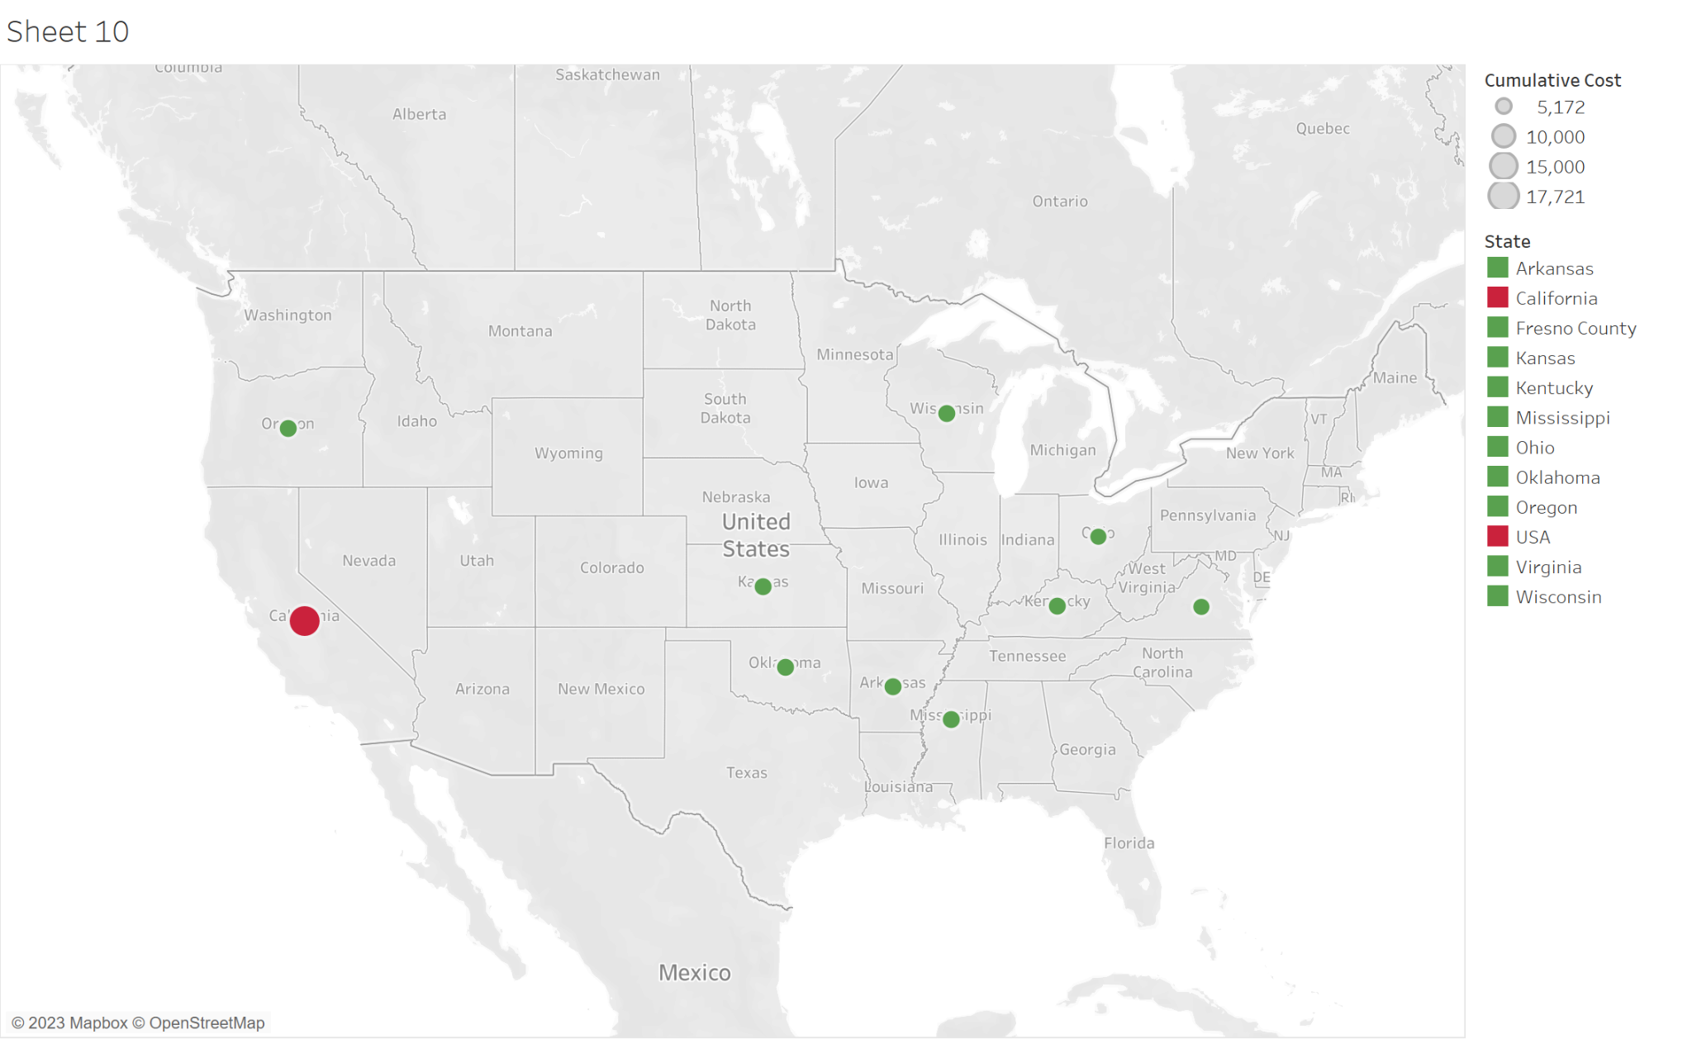
Conclusions
Selective Cost Efficient Regions
google.com

Slide 19
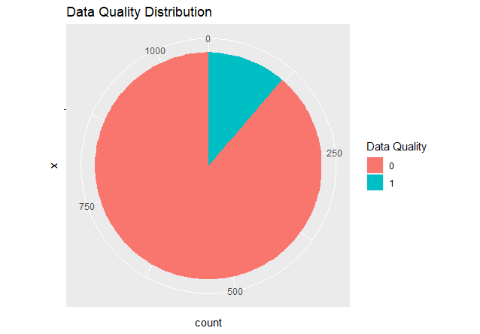
Recommendations - Further Insights
Accuracy being 11%
Potential to improve Data
Focused only on Employees and Operations Costs
google.com

Slide 20
Optimizing For The Future
Relocating Google's Headquarters - A Cost of Living Analysis
Presenter: Adhithya Rokhith Bhaskar

